Slide 1



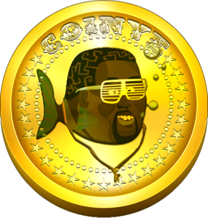




Introduction to Cryptographic Currencies
Date=30-12-19

Slide 2
crypto currency

Slide 3
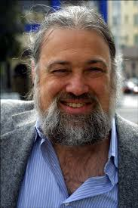
The 1990s David Chaum and anonymous ecash
“The difference between a bad electronic cash system and well-developed digital cash will determine whether we will have a dictatorship or a real democracy”
(attributed to Chaum)

Slide 4


Chaum’s anonymous e-cash
anonymous
secure (no double-spending)
only transfer (no creation/storage)
…and bankrupted in 1999

Slide 5
The advent of Bitcoin
2009: Bitcoin announced by Satoshi Nakamoto
Pseudonym for person or group of person
2009-2011: slow start…
2011-2013: Silk Road and Dread Pirate Roberts
End 2013: Bitcoin price skyrockets
and the world notices!

Slide 6




Outline
Part 0: a little history
Part 1: TheoryCoin
How to create coins
How to transfer coins
How to store coins
Part 2: diff( , )
Part 3: Problems and issues

Slide 7
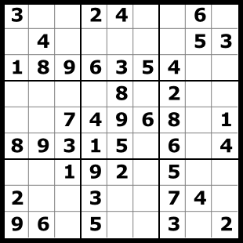

TheoryCoin: How to create money
Everyone tries to solve a puzzle
The first one to solve the puzzle gets 1 TC
The solution of puzzle i defines puzzle i+1

Slide 8
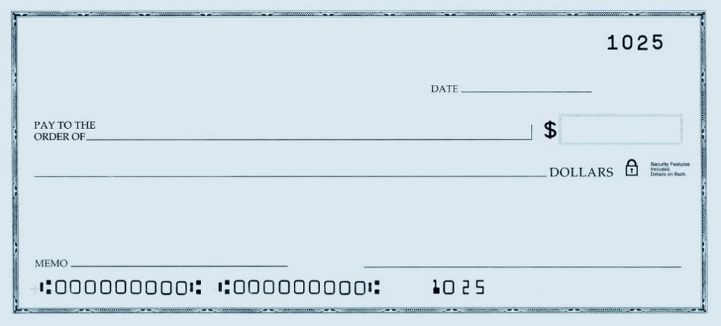
TheoryCoin: How to transfer money
(Digital) Signatures
Only you can sign
Everyone can verify
You cannot deny
Give coin 3 to Jesper
Claudio

Slide 9
TheoryCoin: How to transfer money
Gen
“Your pin code”
“Your username”
secret key
public key
message
message, signature
accept/reject
Sign
Verify

Slide 10
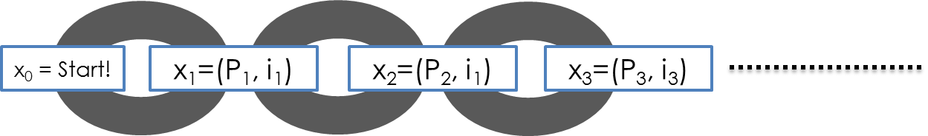
TheoryCoin: How to store money
Main Idea:
Record transfers in the blockchain

Slide 11
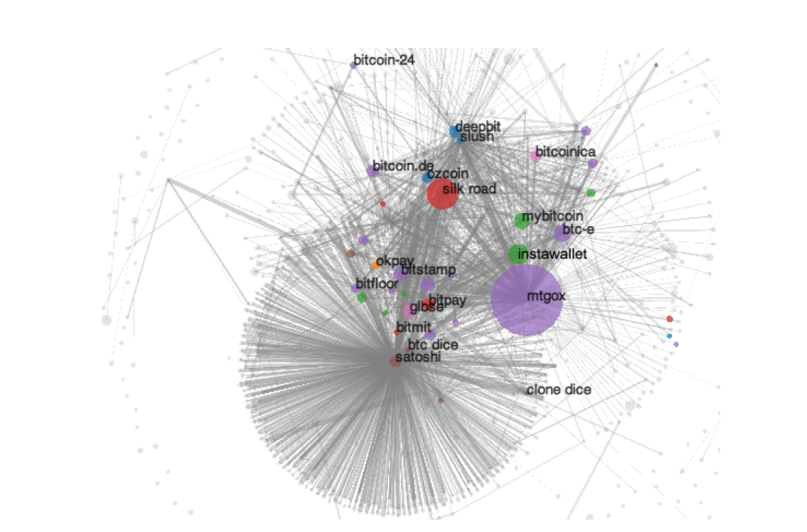
Anonymity?
Problem:
Every transaction ever made is recorded forever
Solution?
Use new identity for each transaction
But:
Heuristics allow to cluster identities
Anonymous alternatives:
Zerocoin, Zerocash…

Slide 12
Programmable money?
“Bitcoin uses a scripting system for transactions. Forth-like, Script is simple, stack-based, and processed from left to right. It is purposefully not Turing-complete, with no loops.”
E.g., “P1 gives 1 BTC to P2 if at least 2 out of (P1,P2,P3) sign this transaction”
Functionality: more than money?
Security: malware payments?

Slide 13
Mining pools
Solving puzzles (mining) is hard!
Miners join pools and share work/reward
How to optimally split work?
Mechanism design?
rational miner?
how to allocate reward?

Slide 14
A final word…
Distributed currencies:
for the good guys or the bad guys?
Crime is bad! Tax evasion is bad!
But sometimes governments are bad too!
Thanks! Questions?

Slide 15
Sources:
Learn about signatures/ecash/cryptography at csaudk https://services.brics.dk/java/courseadmin/crypto/ https://services.brics.dk/java/courseadmin/cpt https://services.brics.dk/java/courseadmin/CryCom
Story of Chaum and DigiCash (to be taken with a grain of salt) http://cryptome.org/jya/digicrash.htm
Bitcoin paper and announcement http://article.gmane.org/gmane.comp.encryption.general/12588/ http://www.mail-archive.com/cryptography@metzdowd.com/msg10142.html
This pizza cost 750,000 usd http://motherboard.vice.com/blog/this-pizza-is-worth-750000
Lily Allen turns down btcs https://twitter.com/lilyallen/statuses/419942070770741249
Signature attack http://eprint.iacr.org/2013/734
Deanonymizing http://cseweb.ucsd.edu/~smeiklejohn/files/imc13.pdf http://eprint.iacr.org/2012/584
Zerocoin/Zerocash http://zerocoin.org/
Graphs, stats etc www.blockchain.info
Comparison with Altcoins http://www.coinwarz.com/cryptocurrency
Bitcoin stolen from TV http://nymag.com/daily/intelligencer/2013/12/bloomberg-anchors-christmas-bitcoin-gets-stolen.html
Visa/Mastercard vs Wikileaks http://www.forbes.com/sites/andygreenberg/2010/12/07/visa-mastercard-move-to-choke-wikileaks/
Not in the talk, but very interesting:
Silkroad essentials http://exitevent.com/privacy-tor-btc-and-what-the-silk-road-crackdown-means-to-you-131112.asp http://arstechnica.com/tech-policy/2013/10/how-the-feds-took-down-the-dread-pirate-roberts/ http://pando.com/2014/01/02/with-130m-of-bitcoin-wealth-and-plans-to-sell-the-fbi-could-rattle-the-virtual-currency-cage
The value overflow bug https://en.bitcoin.it/wiki/Common_Vulnerabilities_and_Exposures#CVE-2010-5139
The March 2013 chain fork https://bitcoin.org/en/alert/2013-03-11-chain-fork
Buggy transaction, mistery miner https://blockchain.info/tx-index/3618498/4005d6bea3a93fb72f006d23e2685b85069d270cb57d15f0c057ef2d5e3f78 https://bitcointalk.org/index.php?topic=67634.0
The problem with “checkpointed” bitcoin http://www.links.org/files/decentralised-currencies.pdf
This presentation contains copyrighted images the use of which has not always been specifically authorized by the copyright owner. I am making the material available for educational purposes only and I believe this constitutes a 'fair use'.

Slide 16
Presented by:
Usama Saleem
Adil Arif
Syed Zain ul Abedin

